Slide 1
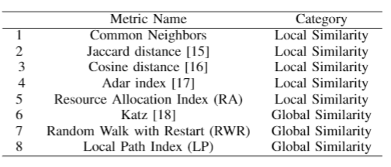
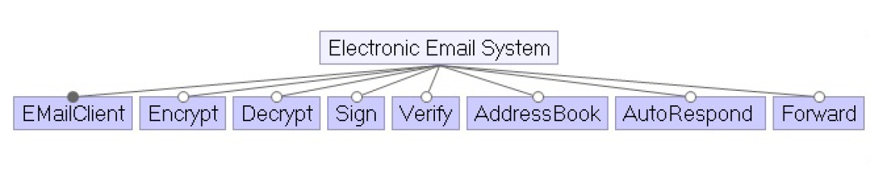
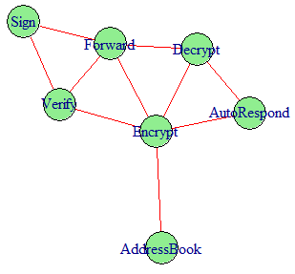
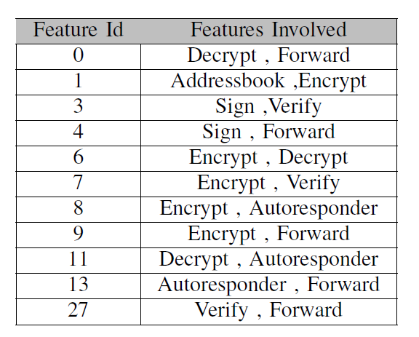
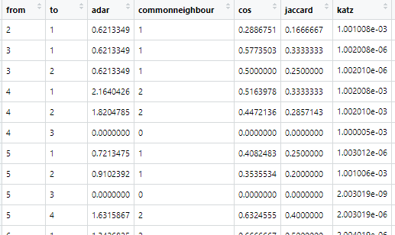
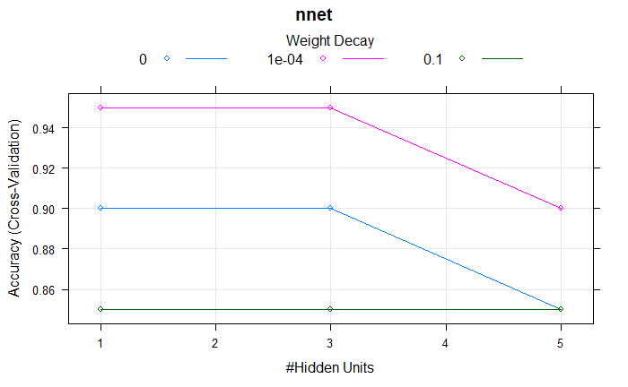
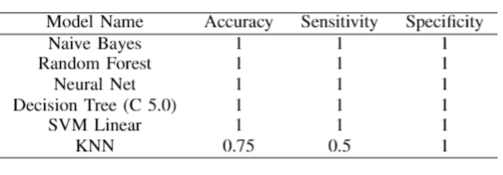
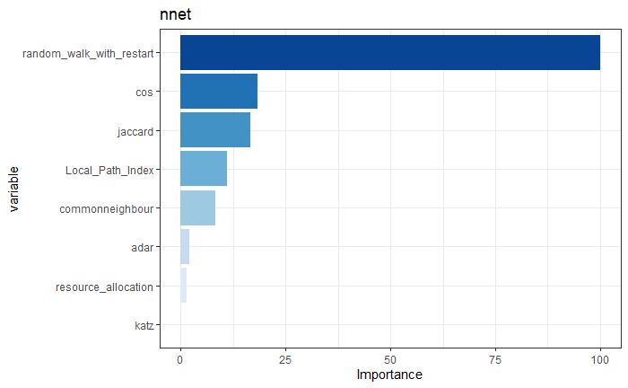

Software Repository
Feature Interaction Graph
Feature Diagram
Unwanted Feature Interactions
Calculation of Similarity Indexes
Testing Machine Learning
(on 20% of data)
Saved Machine Learning model
Automatically detected missing or new unwanted feature interactions
Designing of new version or products
Training Machine Learning
(on 80% of data)

